Slide 1


Shrinkage and reliability in neuro-connectivity (srinc): An interactive tool to explore reliability of whole-brain neuroconnectivity estimates by scan duration
Amanda Mejia Dan Kessler Robert Welsh Stephanie Noble

Slide 2
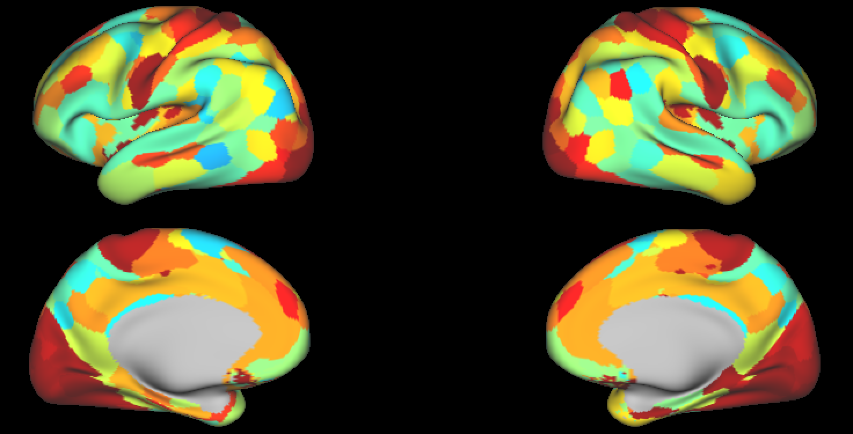
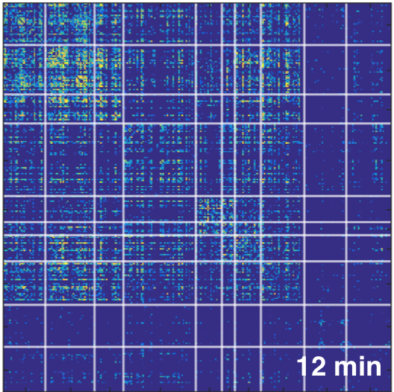
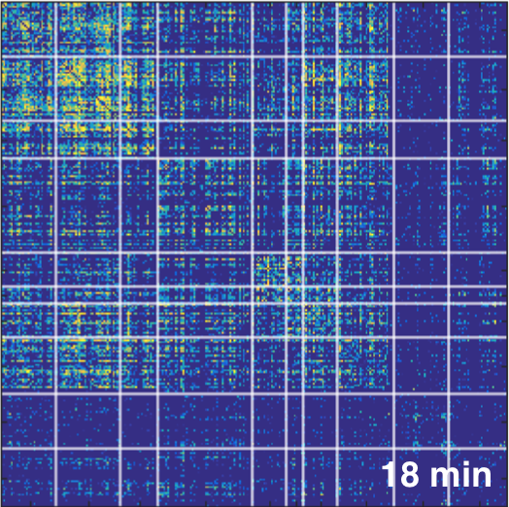
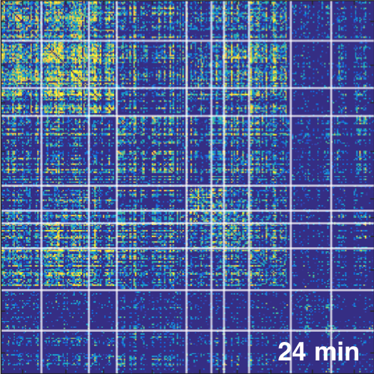
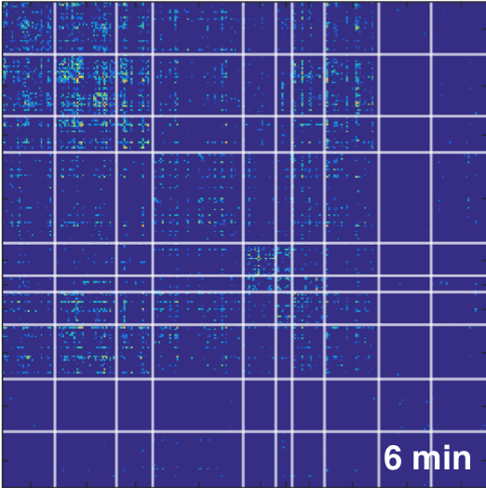
Select Seed & Target
Seed
Target
Filter by Network
Filter by Network
(select one)
(select one)
Choose Seed
Choose Seed
(select one)
(select multiple)
Reliability by Scan Length
excellent
good
Reliability (e.g. ICC)
fair
poor
Scan duration

Slide 3
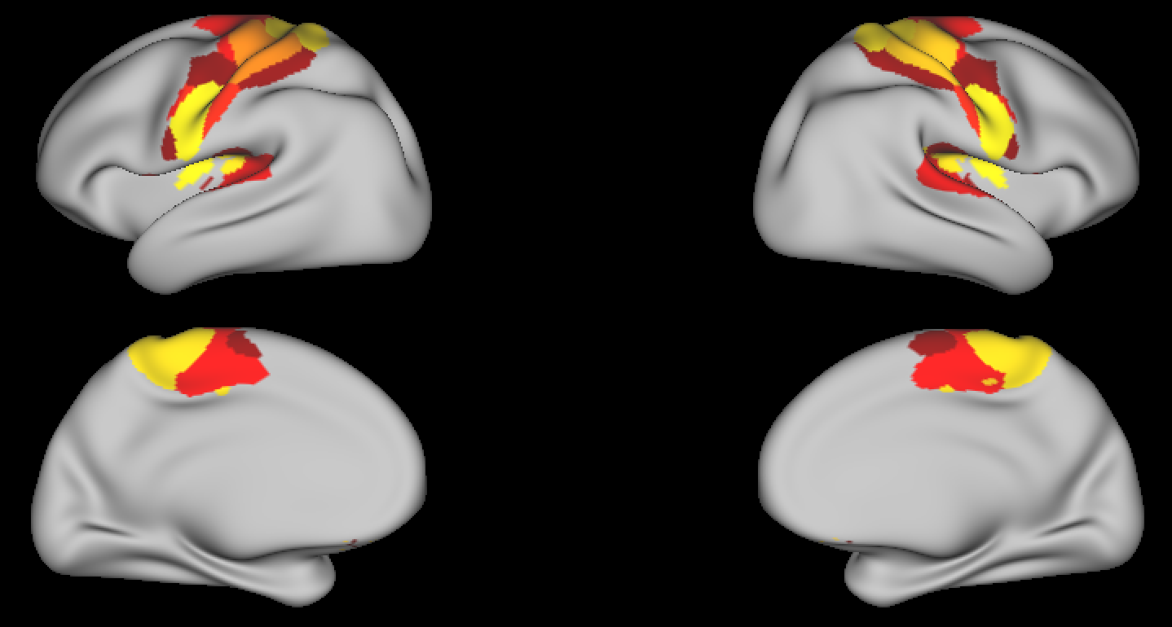
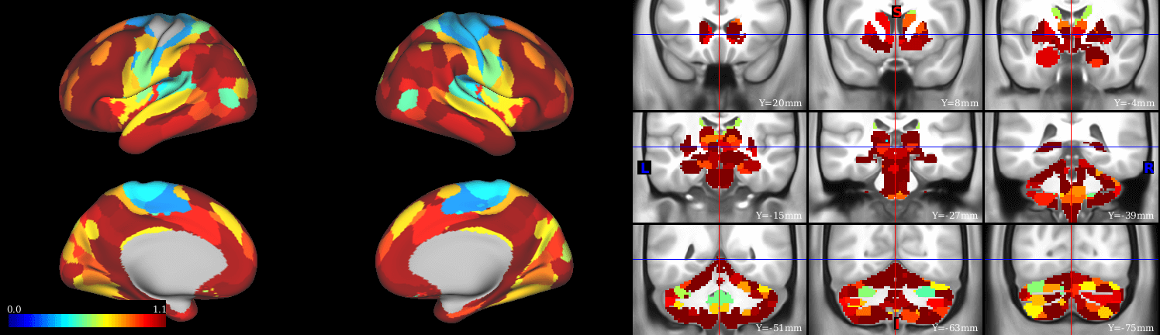
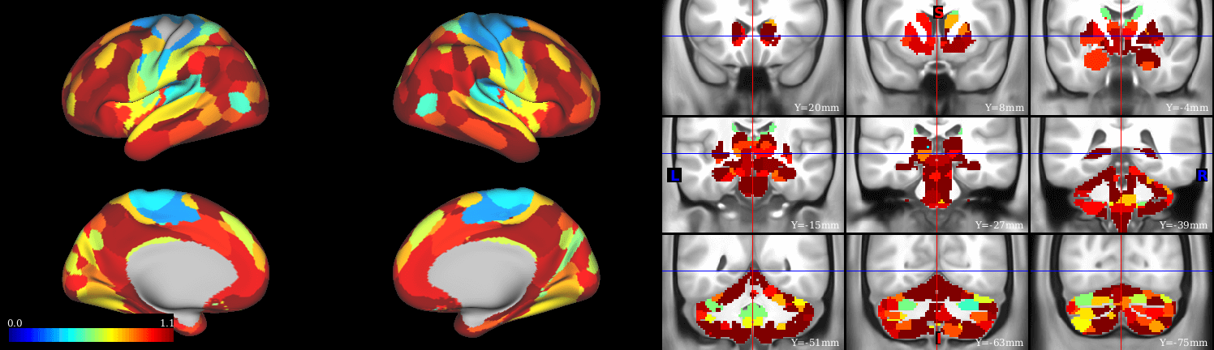
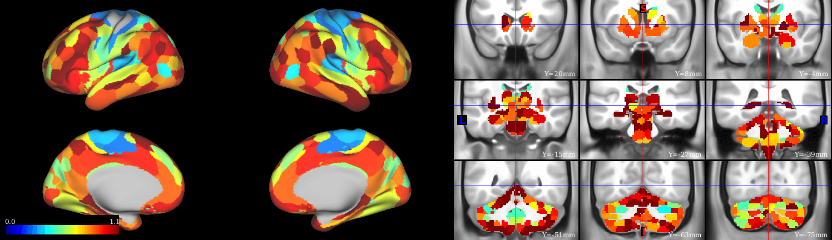
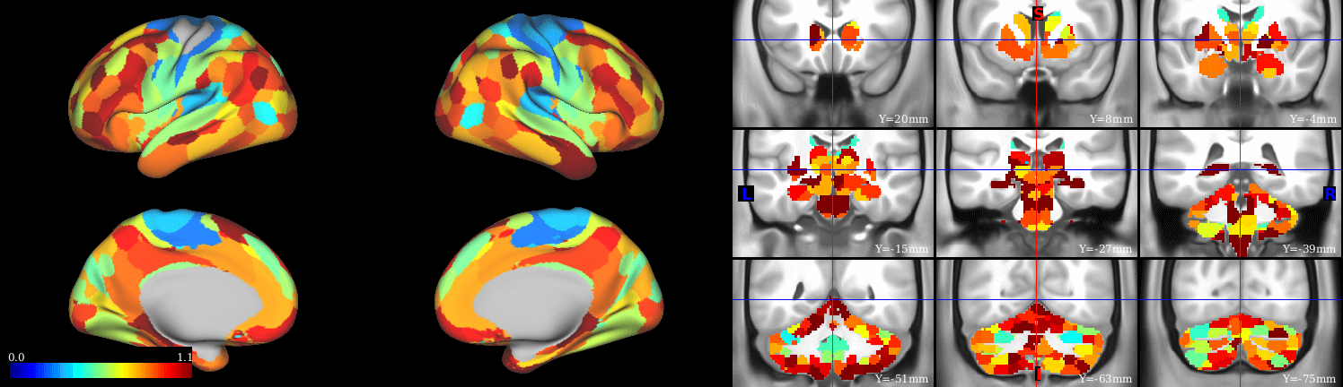
Select Seed & Target
Seed
Target
Filter by Network
Filter by Network
Motor Network
(select one)
Choose Seed
Choose Seed
21 (dorsal motor)
(select multiple)
Reliability by Scan Length
excellent
good
Reliability (e.g. ICC)
fair
poor
Scan duration

